Slide 1
OUT for Safe Schools
Supporting LGBTQ youth at your site

Slide 2
What Is OUT for Safe Schools?
Created by Los Angeles LGBT Center, LAUSD and GSA Network.
National OUT for Safe Schools 2015 campaign included:
Los Angeles Unified
Duval County Public Schools
Boston Public Schools
Chicago Public Schools
New York City Department of Education
Oakland Unified School District
San Diego Unified School District
San Francisco Unified School District
District of Columbia Department of Education
District of Columbia Public Schools.

Slide 3
Purpose of OUT Badges:
Encourage school staff (including administrators, teachers, nurses, counselors, food service personnel, custodial staff, bus drivers, etc.) to publicly identify as supportive LGBTQ+ allies.
Visual display of support lets students know who represents a “safe space” and that safe spaces are not limited to the classroom.
Staff who wish to participate can wear the badges, which displays their willingness to talk to students and parents about LGBTQ+ concerns.
Foster an inclusive community and create safe space and resources for LGBTQ+ students, staff and parents, and for all students to celebrate all identities.

Slide 4
How To Be an Ally
Declare that you are a safe space ambassador to all LGBTQ+ students.
Advocate for the safety, inclusion and celebration of LGBTQ+ individuals.
Stand up for an LGBTQ+ individual.
Speak out against hurtful language.
Proactively work to ensure that school climate policies and practices are safe and inclusive for LGBTQ+ individuals.
Refer to resources, as needed.

Slide 5
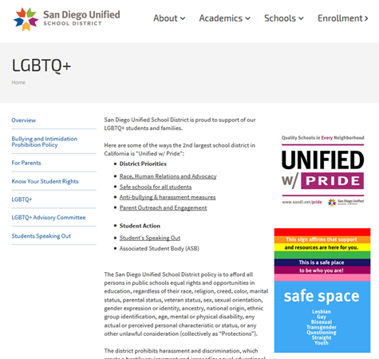
Resources and Referring
Badge Resources
www.sandiegounified.org/safe
District resources
www.sandiegounified.org/lgbtq

Slide 6
Rolling Out Program at Your Site
Coordinate with your Site Administrator to present to all staff.
Refer to www.sandiegounified.org/safe for staff resources:
PowerPoint
FAQs
Principal and Parent Letter templates
Provide participating staff with:
Badges
Lanyards
FAQs (please print or email to your staff)
Badges are to be worn voluntarily by staff.
If your site needs additional badges, please contact us.

Slide 7
Upcoming Supportive Efforts
SDUSD Local School Climate Survey
LGBTQ+ Site Trainings
Implementing Lessons that Matter – LGBTQ-Inclusive Curriculum (April 12th)
Healthy Relationships Workshops for LGBTQ Youth and Allies (May 3rd)

Slide 8
Questions and Concerns?
Office of youth advocacy
Sexual health education program
Sophia Arredondo
sarredondo@sandi.net
Mick Rabin
mrabin@sandi.net
(619) 725-5595
Rachel Miller
rmiller@sandi.net
(619) 725-7121

